Slide 1



INSTITUTE: UIE (AIT-CSE)
CSS21: B.E. CSE (H) with specialization in Artificial Intelligence & Machine Learning
Advanced Machine Learning (20CSF-349)
Chapter 3.1.2 & 3.1.3: Tree Models
Lecture 32 & 33: Class Evaluation Measures & ROC curve
By: Mr. Siddharth Kumar
DISCOVER . LEARN . EMPOWER

Slide 2
Advanced Machine Learning
Course Outcome
CO | Title
1 | Have a good understanding of the fundamental issues and challenges of machine learning: data, model selection, model complexity, etc.
2 | Appreciate the underlying mathematical relationships within and across Machine Learning algorithms and the paradigms of supervised and un-supervised learning
3 | Design and implement various machine learning algorithms in a range of real-world applications.
4 | Design and evaluate intelligent expert models for perception and prediction using machine learning algorithms
5 | Analyze and make use of machine learning algorithms-based applications using performance

Slide 3
Class Evaluation Measures
Evaluation is always good in any field right! In the case of machine learning, it is best the practice. In this post, I will almost cover all the popular as well as common metrics used for machine learning.
Confusion Matrix
Classification Accuracy
Precision
Recall
F1 score or F-measure
Area under Curve
Mean Absolute Error
Mean Squared Error

Slide 4
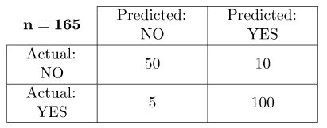
Confusion Matrix
It creates a N X N matrix, where N is the number of classes or categories that are to be predicted. Here we have N = 2, so we get 2 X 2 matrix. Suppose there is a problem for our practice which is a binary classification. Samples of that classification belong to either Yes or No. So, we build our classifier which will predict the class for new input sample. After that, we have tested our model with 165 samples, and we get the following result.
There are 4 terms you should keep in mind:
True Positives: It is the case where we predicted Yes and the real output was also yes.
True Negatives: It is the case where we predicted No and the real output was also No.
False Positives: It is the case where we predicted Yes but it was actually No.
False Negatives: It is the case where we predicted No but it was actually Yes.

Slide 5
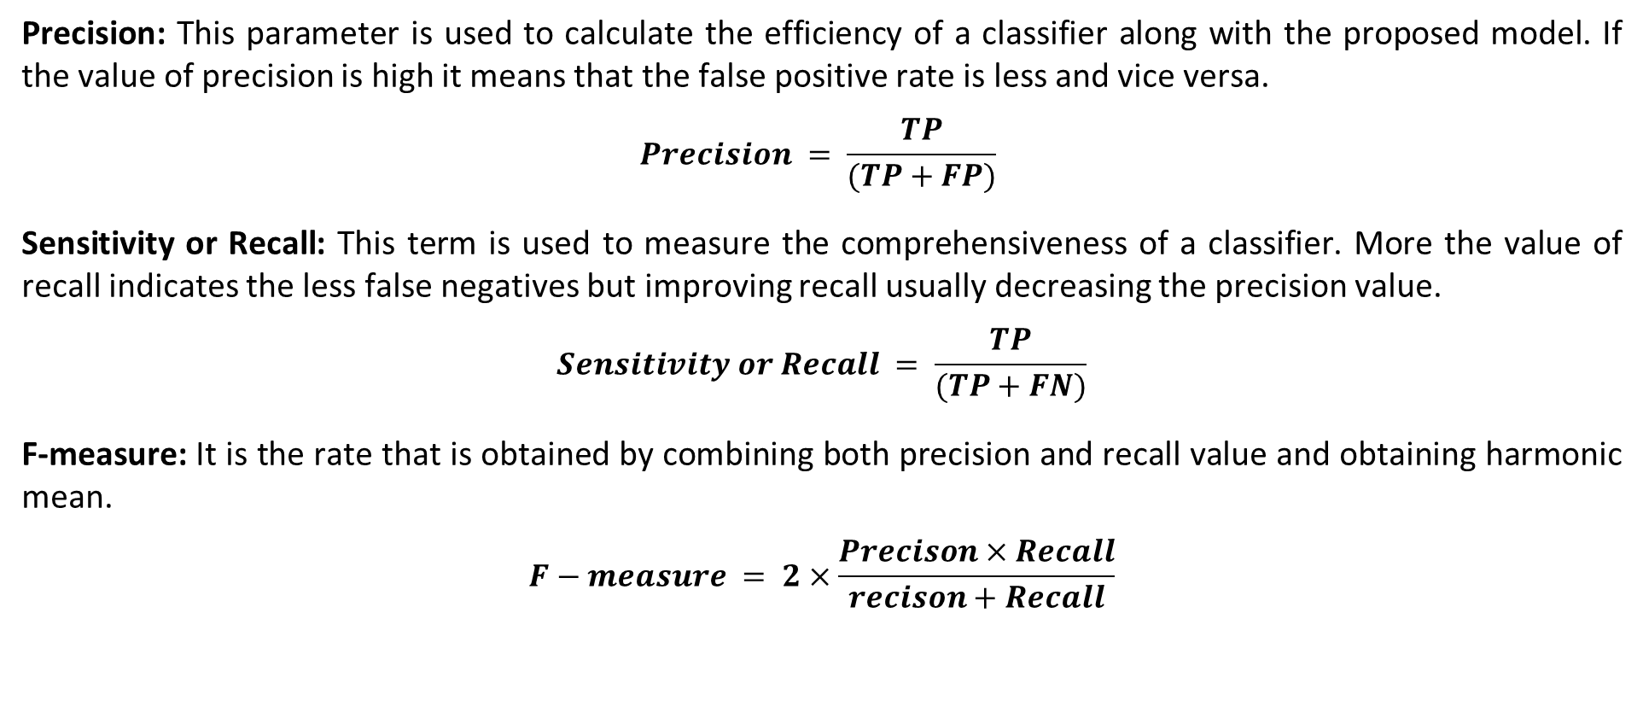
Precision: This parameter is used to calculate the efficiency of a classifier along with the proposed model. If the value of precision is high it means that the false positive rate is less and vice versa.
$$Precision = \frac{TP}{(TP+FP)}$$
Sensitivity or Recall: This term is used to measure the comprehensiveness of a classifier. More the value of recall indicates the less false negatives but improving recall usually decreasing the precision value.
$$Sensitivity or Recall = \frac{TP}{(TP+FN)}$$
F-measure: It is the rate that is obtained by combining both precision and recall value and obtaining harmonic mean.
$$F−measure = 2×\frac{Precison×Recall}{recison+Recall}$$

Slide 6
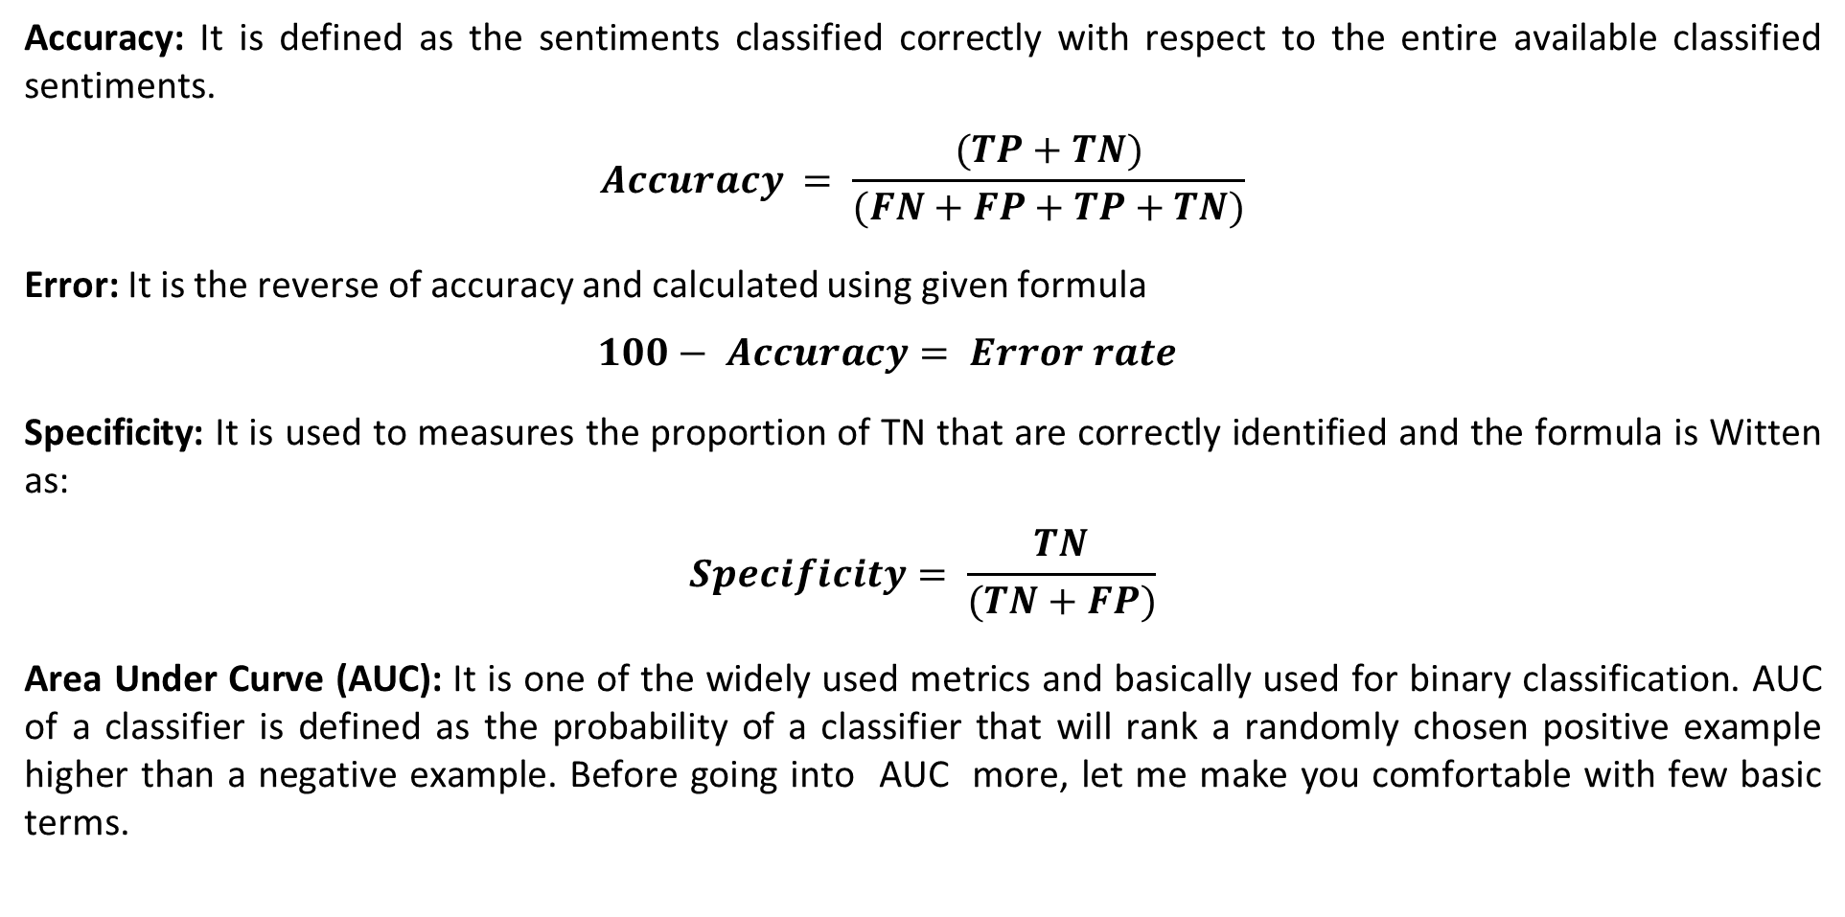
Accuracy: It is defined as the sentiments classified correctly with respect to the entire available classified sentiments.
$$Accuracy = \frac{(TP+TN)}{(FN+FP+TP+TN)}$$
Error: It is the reverse of accuracy and calculated using given formula
$$100− Accuracy= Error rate$$
Specificity: It is used to measures the proportion of TN that are correctly identified and the formula is Witten as:
$$Specificity= \frac{TN}{(TN+FP)}$$
Area Under Curve (AUC): It is one of the widely used metrics and basically used for binary classification. AUC of a classifier is defined as the probability of a classifier that will rank a randomly chosen positive example higher than a negative example. Before going into AUC more, let me make you comfortable with few basic terms.

Slide 7
Mean Absolute Error: It is the average distance between Predicted and original values. Basically it gives how we have predicted from the actual output. However, there is one limitation i.e. it doesn’t give any idea about the direction of the error which is whether we are under-predicting or over-predicting our data.
Mean Squared Error: It is similar to mean absolute error but the difference is it takes the square of average of between predicted and original values. The main advantage to take this metric is here, it is easier to calculate the gradient whereas in the case of mean absolute error it takes complicated programming tools to calculate the gradient. By taking the square of errors it pronounces larger errors more than smaller errors, we can focus more on larger errors.

Slide 8
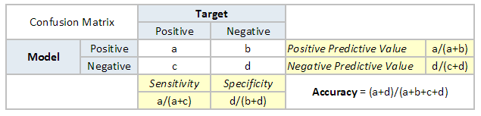
Receiver Operating Characteristic (ROC) Curve
This is again one of the popular metrics used in the industry. The biggest advantage of using ROC curve is that it is independent of the change in proportion of responders. This statement will get clearer in the following sections.
Let’s first try to understand what is ROC (Receiver operating characteristic) curve. If we look at the confusion matrix below, we observe that for a probabilistic model, we get different value for each metric.

Slide 9
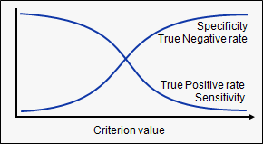
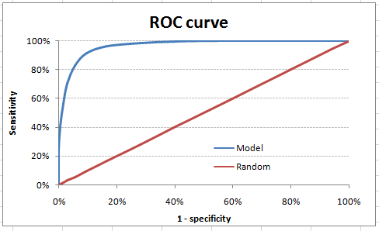
Receiver Operating Characteristic (ROC) Curve
Hence, for each sensitivity, we get a different specificity. The two vary as follows:
The ROC curve is the plot between sensitivity and (1- specificity). (1- specificity) is also known as false positive rate and sensitivity is also known as True Positive rate. Following is the ROC curve for the case in hand.

Slide 10
Advantages of using ROC
Why should you use ROC and not metrics like lift curve?
Lift is dependent on total response rate of the population. Hence, if the response rate of the population changes, the same model will give a different lift chart. A solution to this concern can be true lift chart (finding the ratio of lift and perfect model lift at each decile). But such ratio rarely makes sense for the business.
ROC curve on the other hand is almost independent of the response rate. This is because it has the two axis coming out from columnar calculations of confusion matrix. The numerator and denominator of both x and y axis will change on similar scale in case of response rate shift.

Slide 11
References
T1: Mitchell T.M., Machine Learning, McGraw Hill (1997).
T2: Andreas C. Miller, Sarah Guido, Introduction to Machine Learning with Python, O’REILLY (2001).
Notes:
Introduction to Cyber Security (simplilearn.com)

Slide 12

THANK YOU

